Slide 1
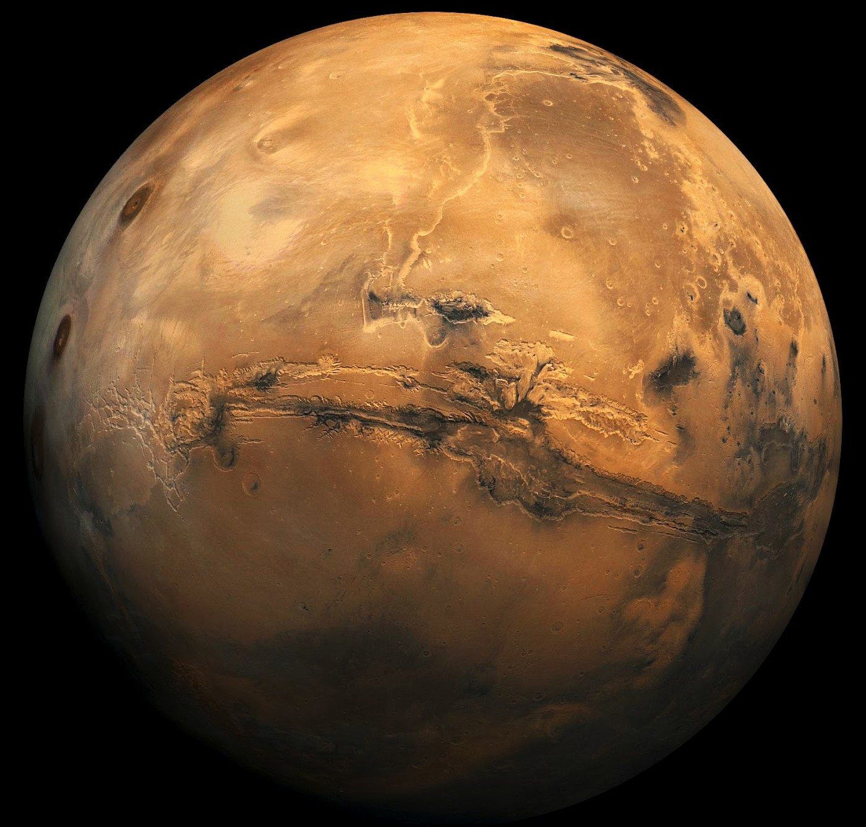
Mars Mysteries
Donna M. Jurdy
Earth & Planetary Sciences
Northwestern University

Slide 2
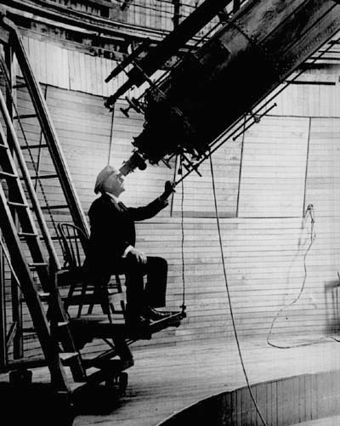
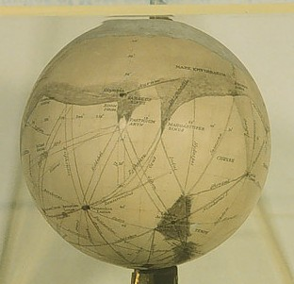
PERCIVAL LOWELL
at his 24” Refractor,
Flagstaff, Arizona observing Mars during the favorable perihelic opposition, 1894.
Below, a globe constructed from his sketches.

Slide 3

H.G. Wells The War of the Worlds
(1898)

Slide 4
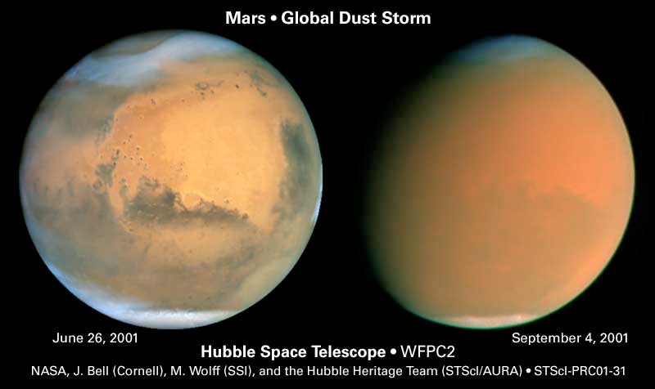

Slide 5
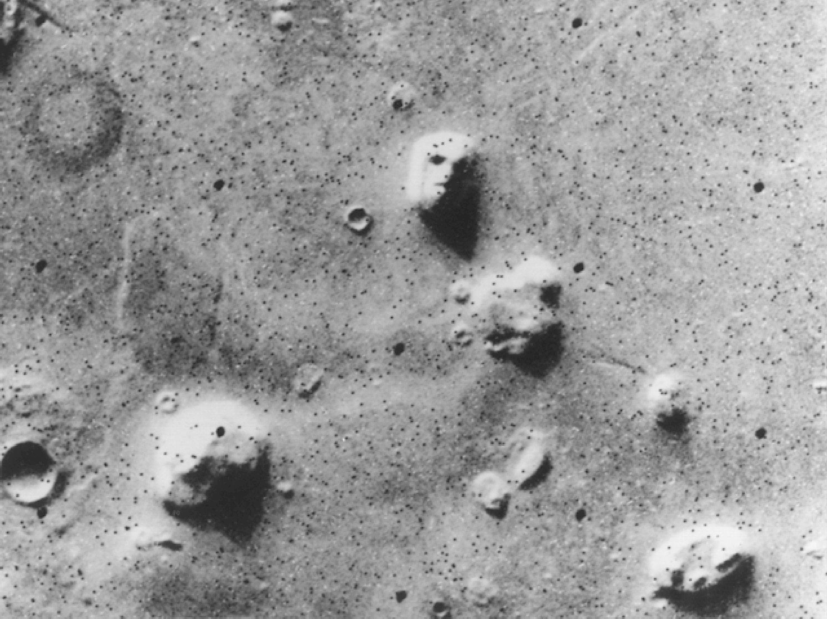

Slide 6
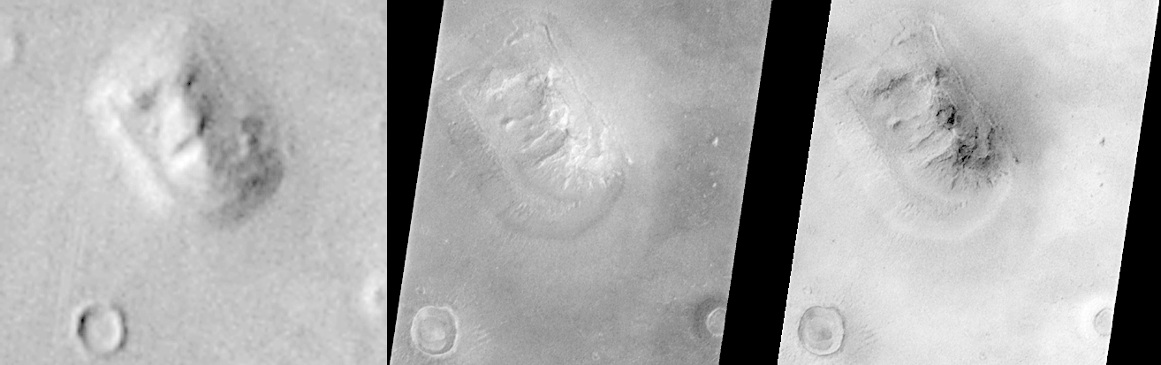
When is a face not a face?

Slide 7
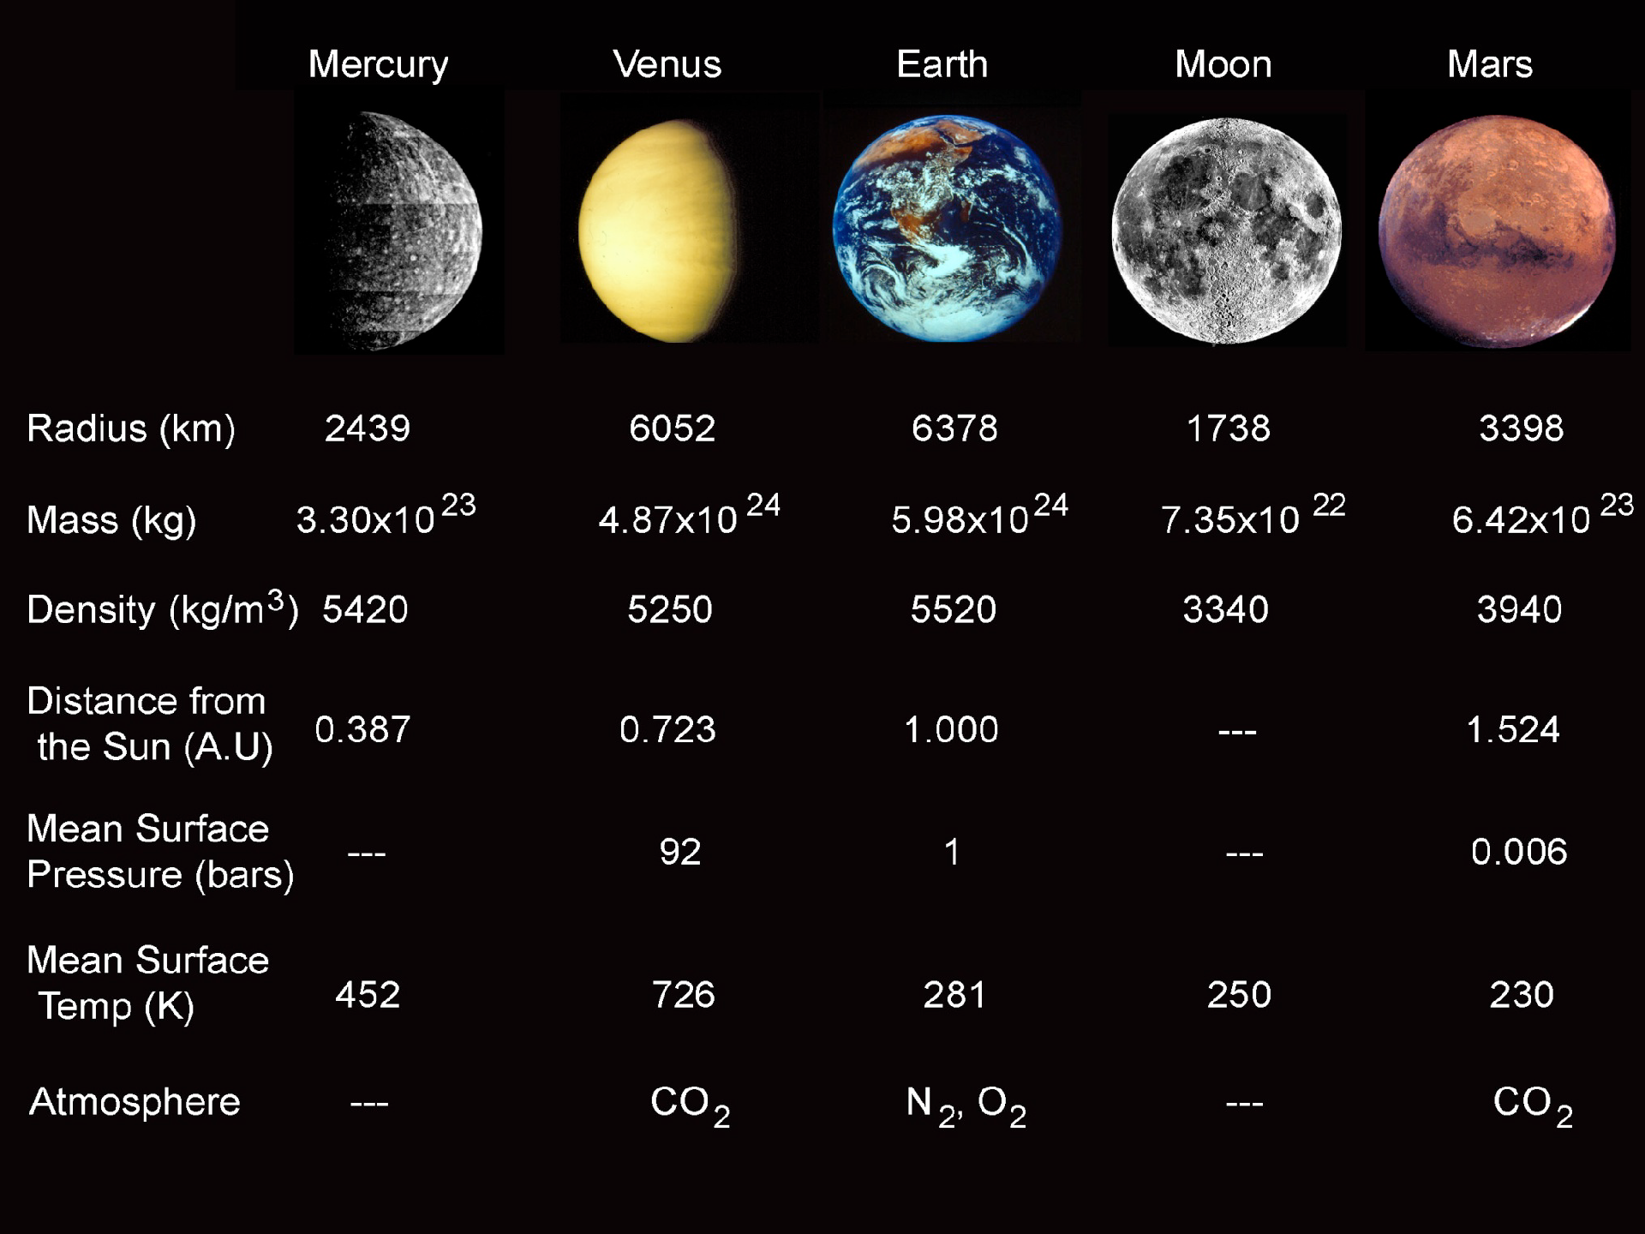

Slide 8
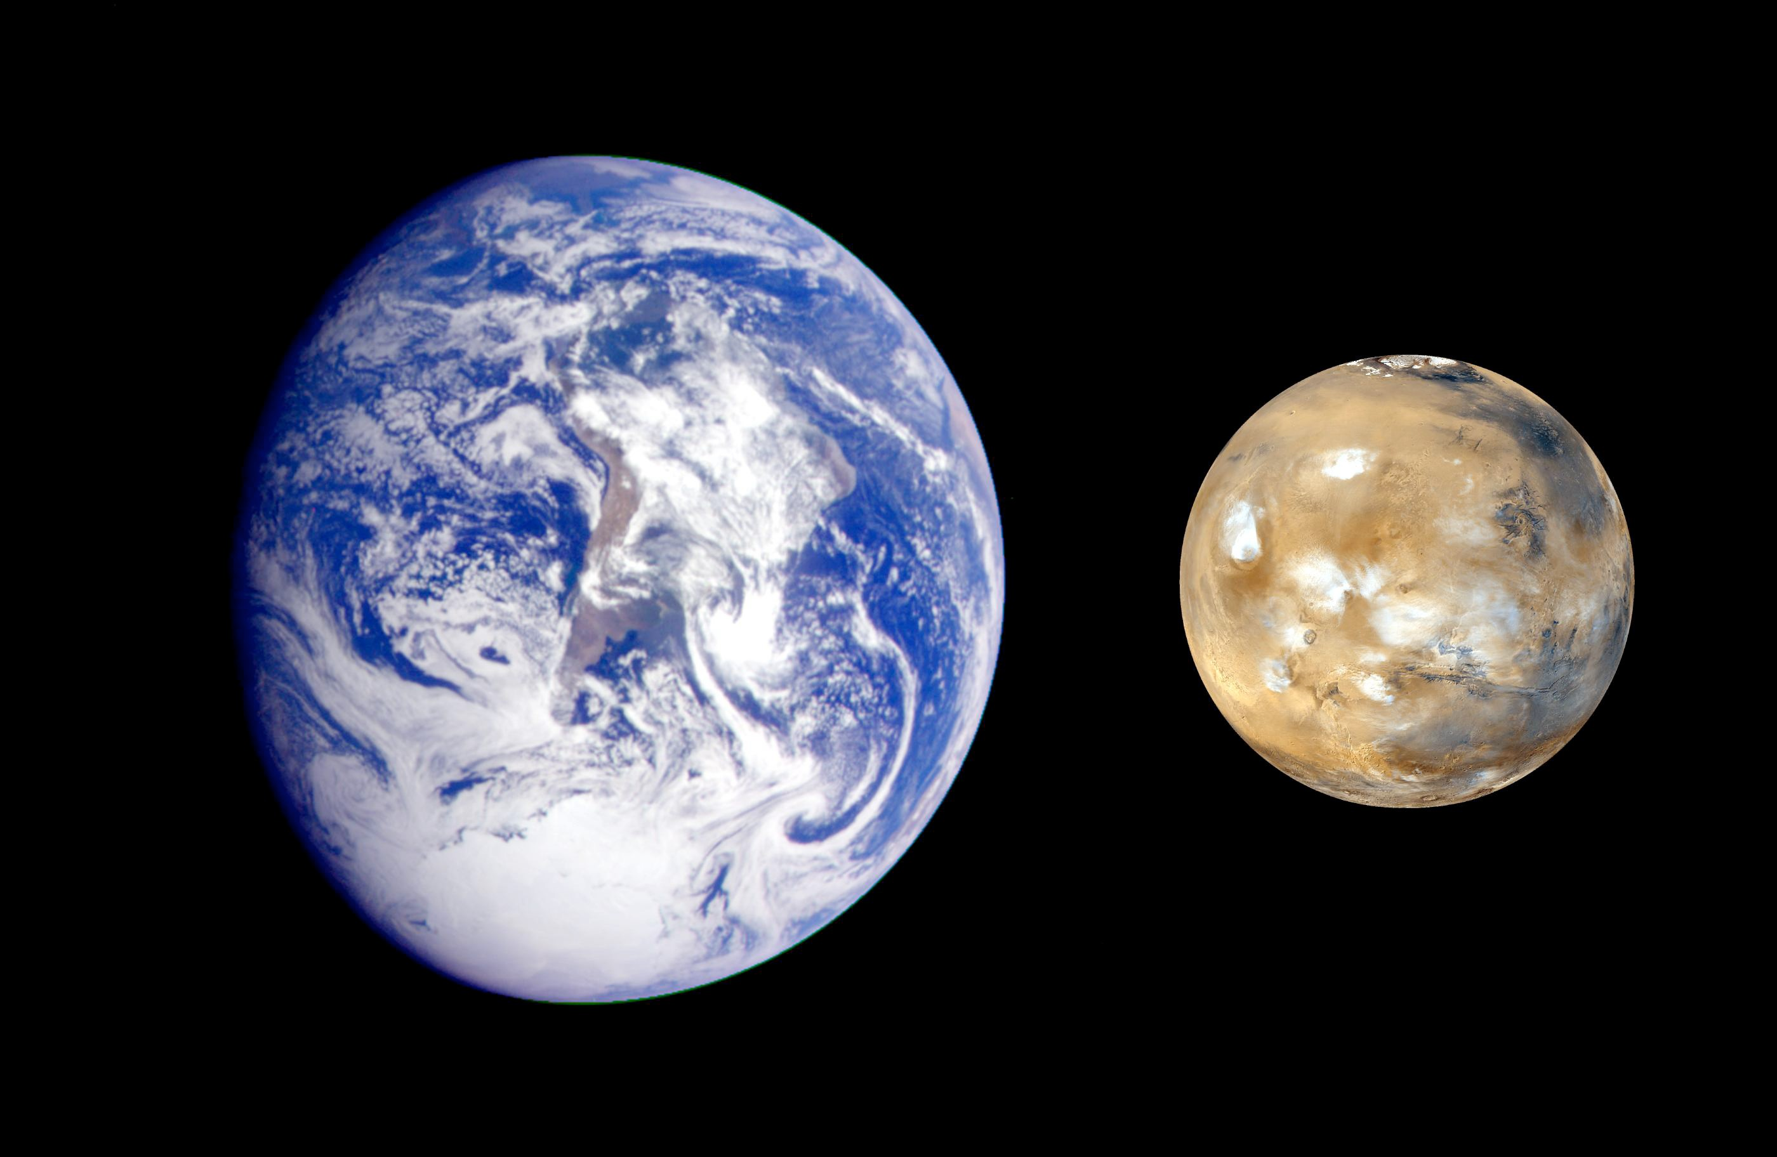

Slide 9
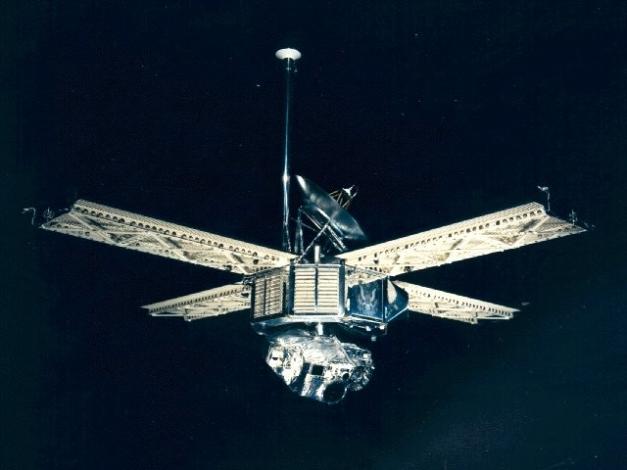
Mariner 7 1969

Slide 10
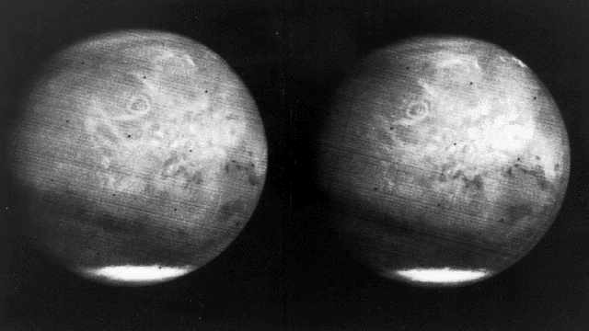
Mariner 7 Approaches Mars

Slide 11
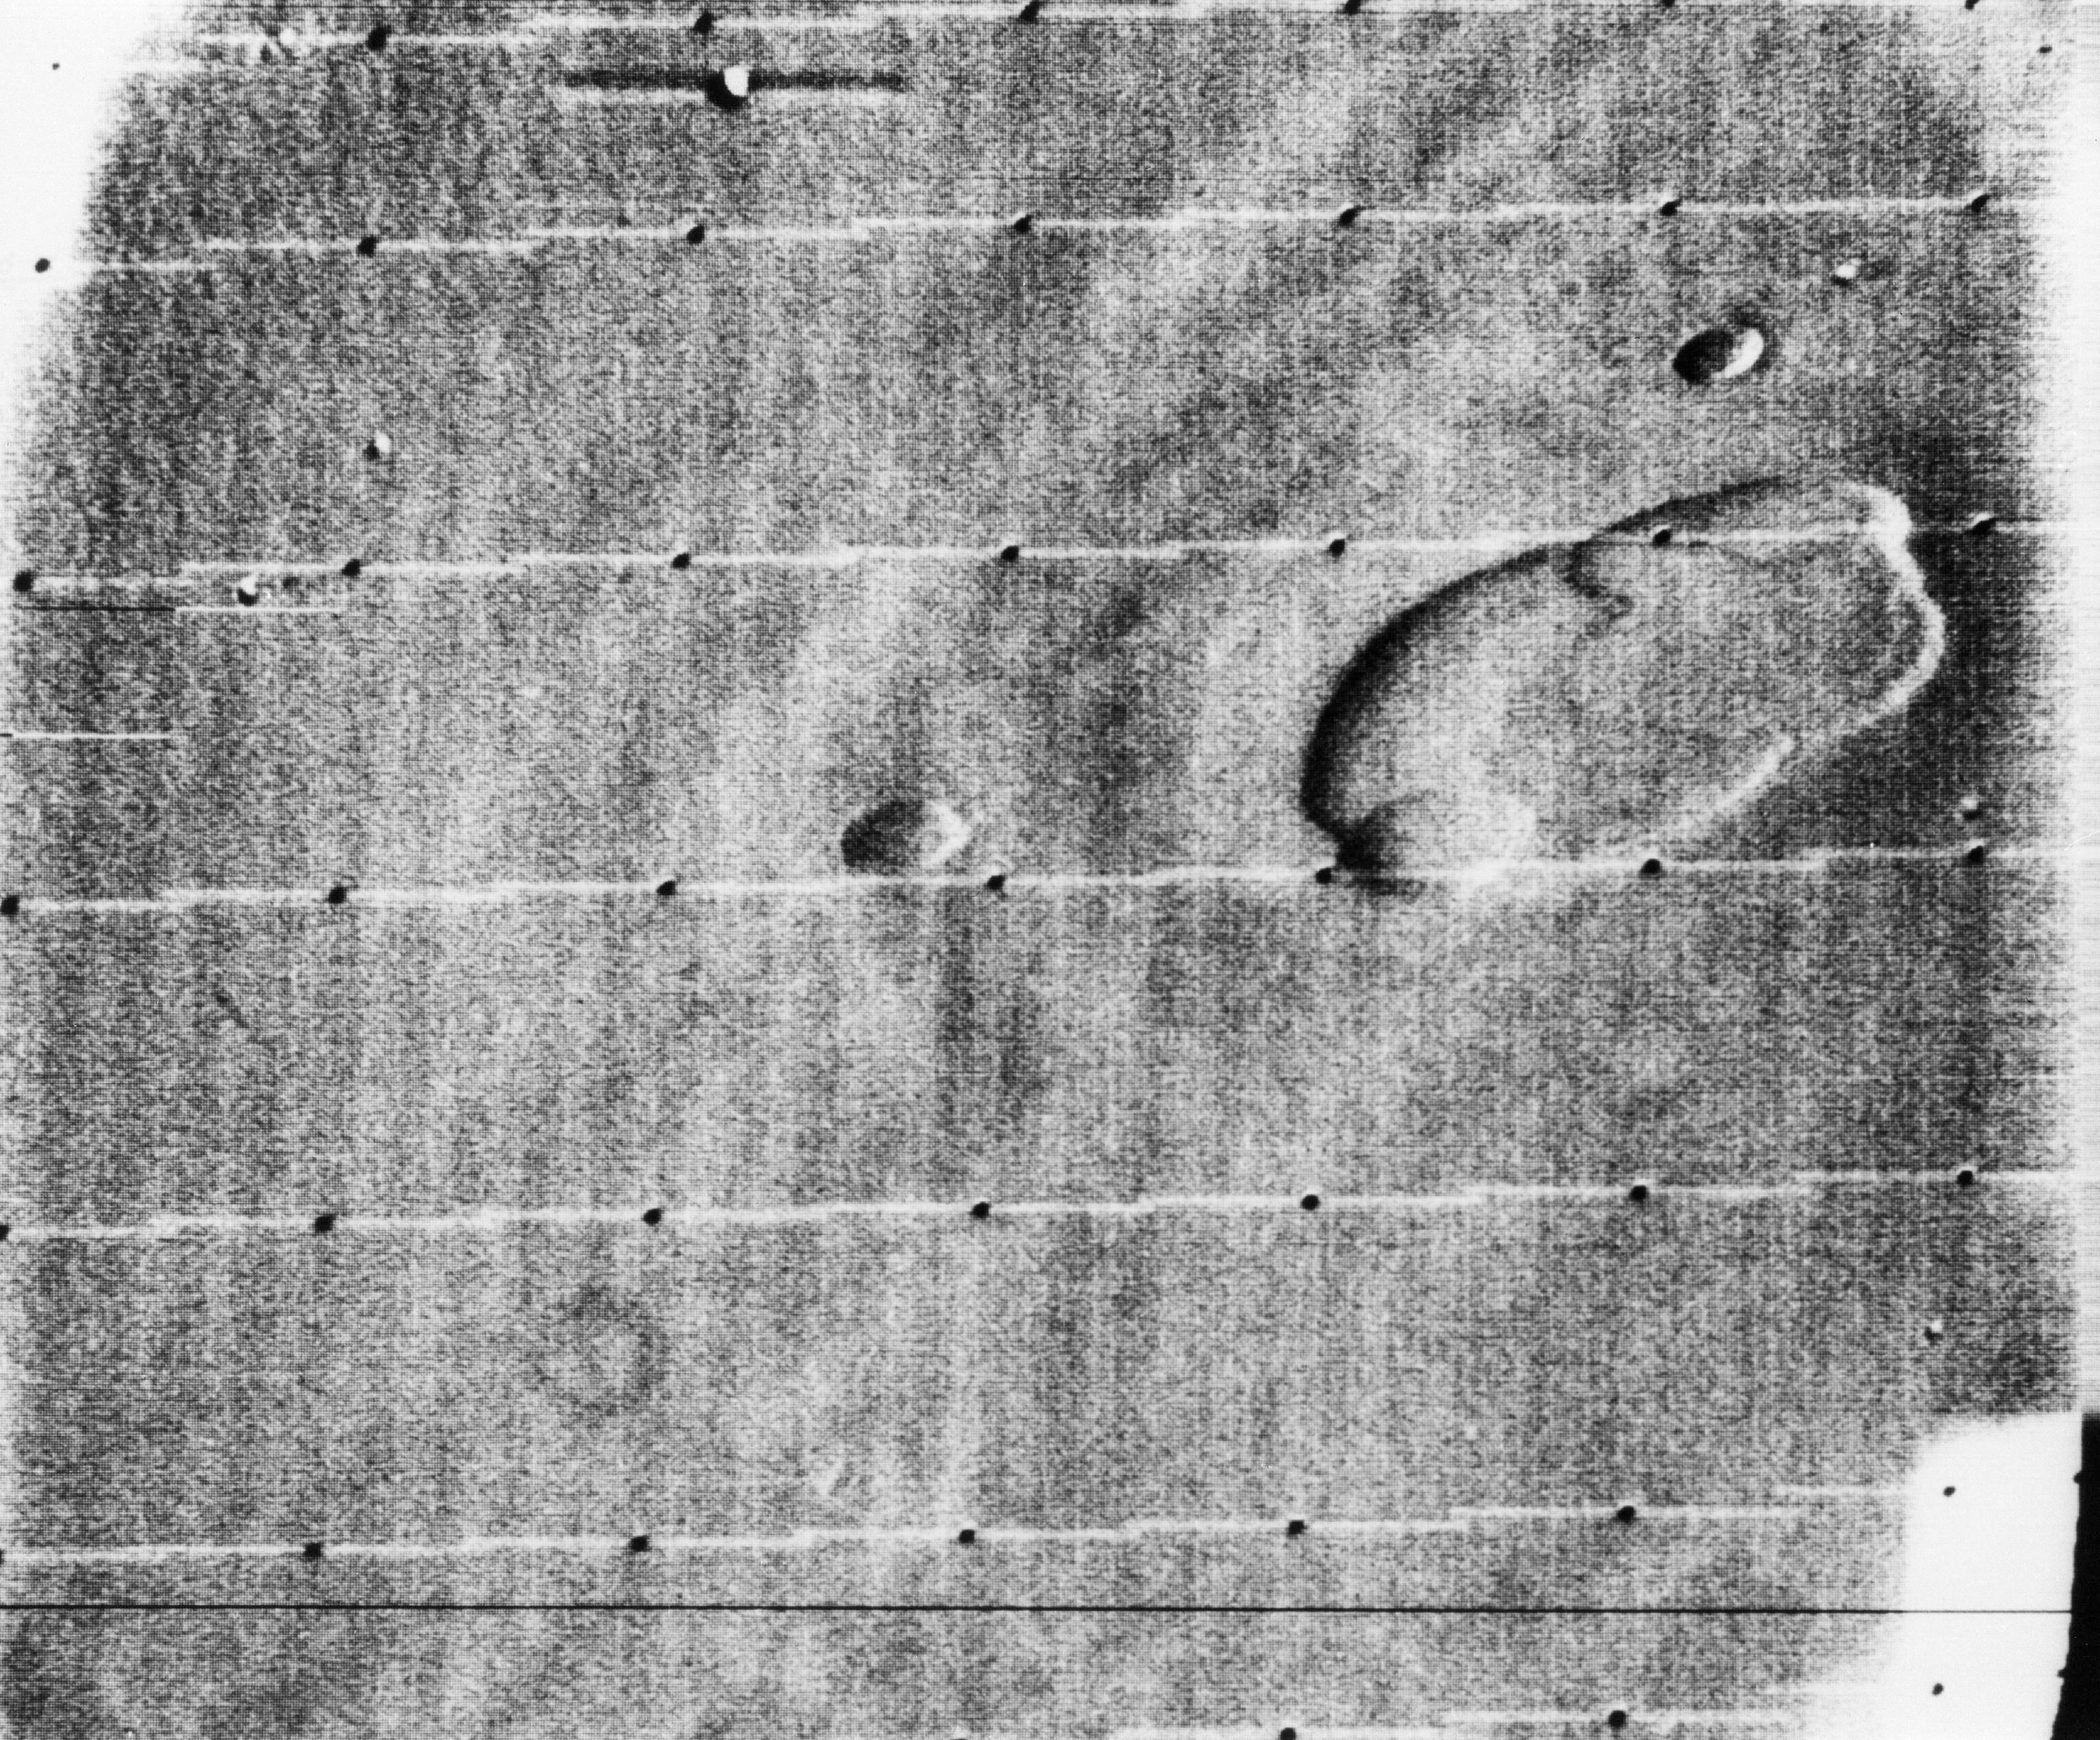
Olympus Mons, as seen from Mariner 9 (1971)

Slide 12
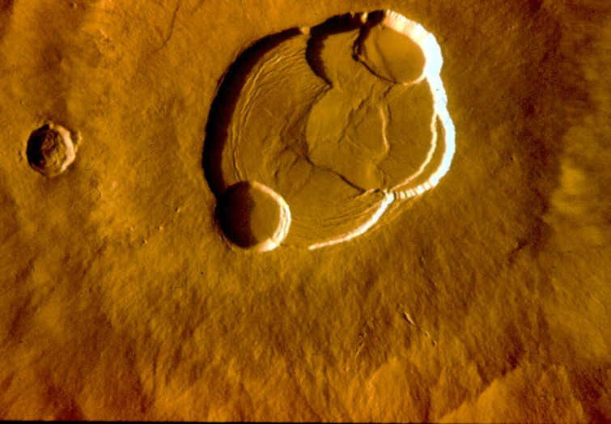
Olympus Mons Caldera

Slide 13
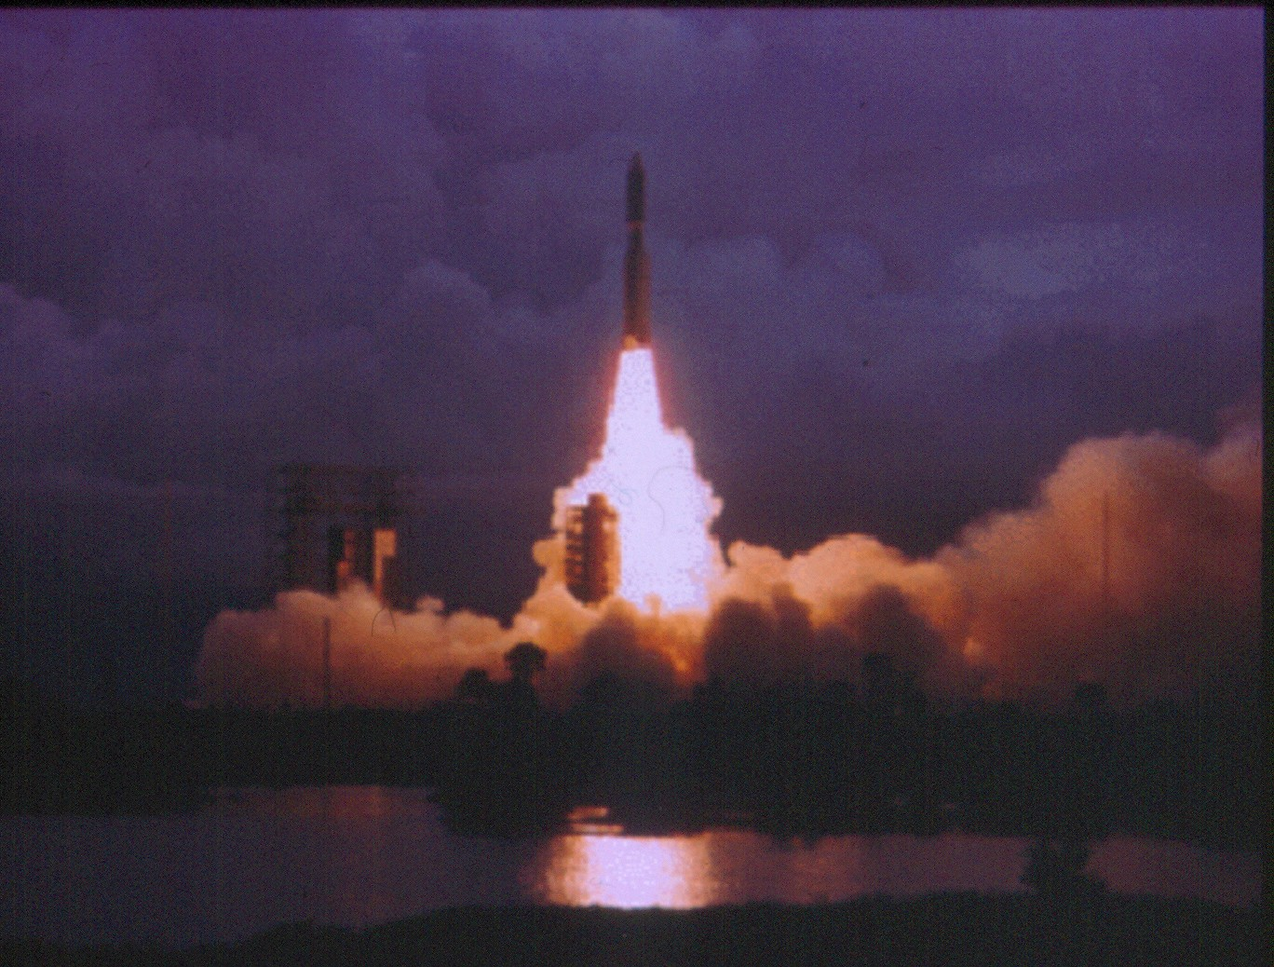
Viking 2 Liftoﬀ - Sept 5, 1975

Slide 14
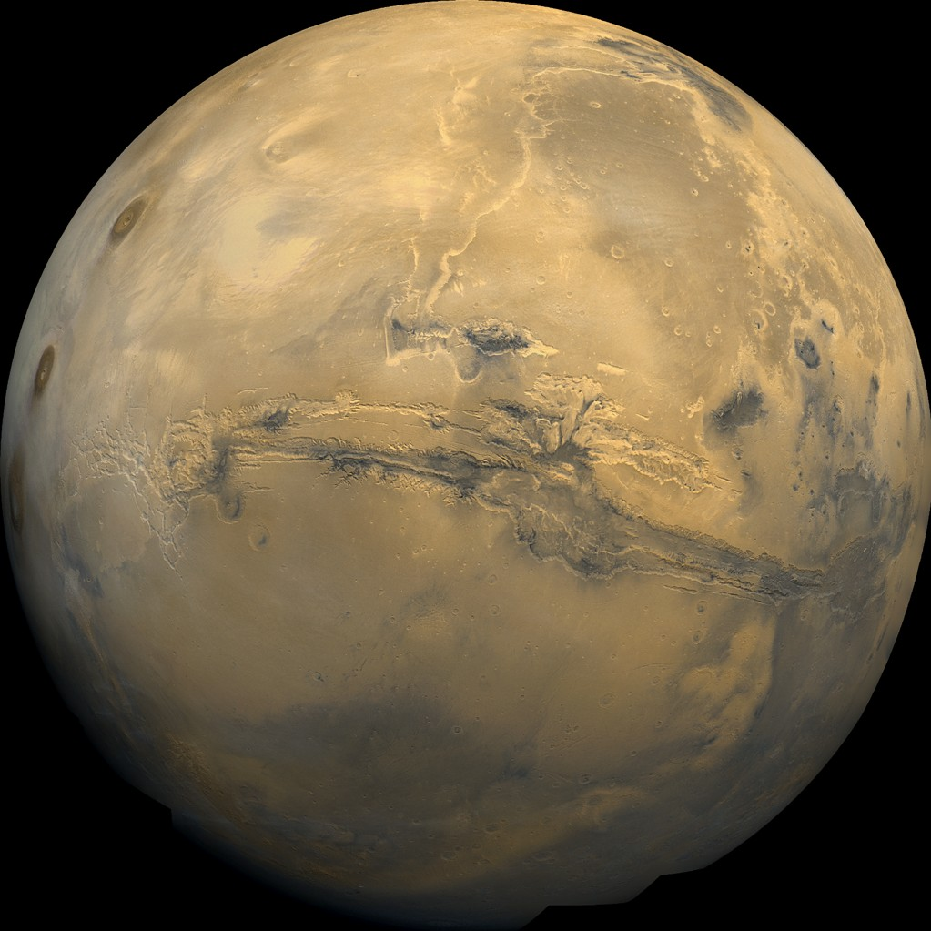
Composite image of Mars
taken by small
telescopes onboard the 2 Viking Orbiters
Mid 1970's

Slide 15
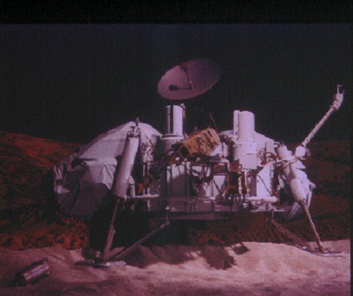
Viking Lander

Slide 16
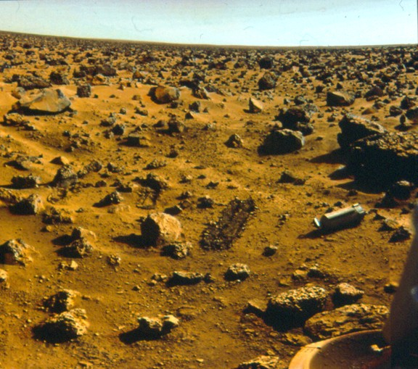
Viking 2 Landing Site (Sept 1976)

Slide 17
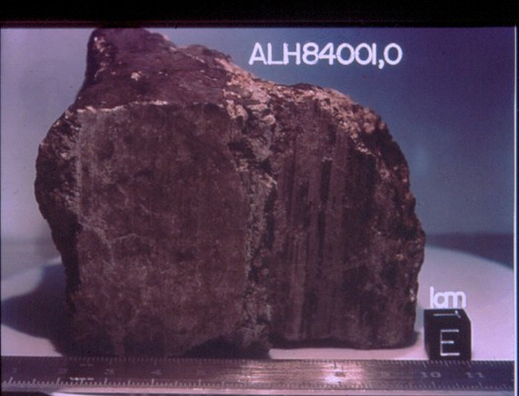
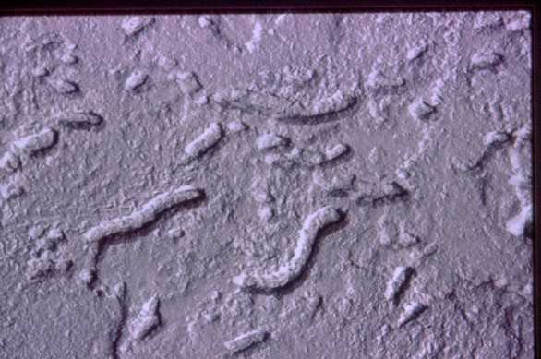
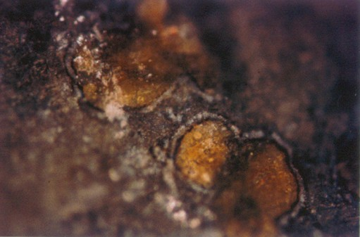
Evidence for (really old, really tiny) Martians?

Slide 18
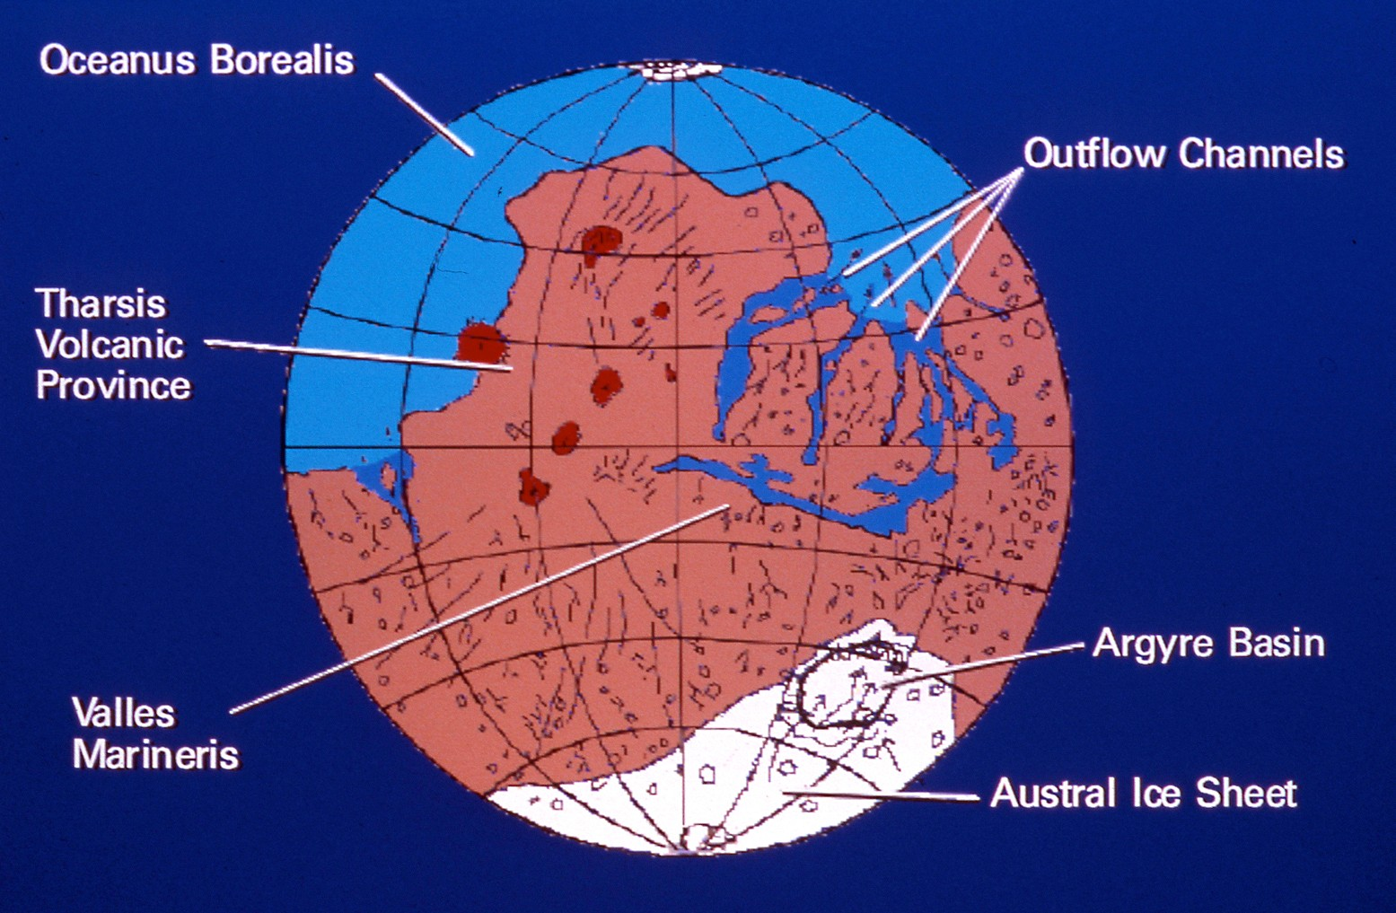
Mars Oceans

Slide 19
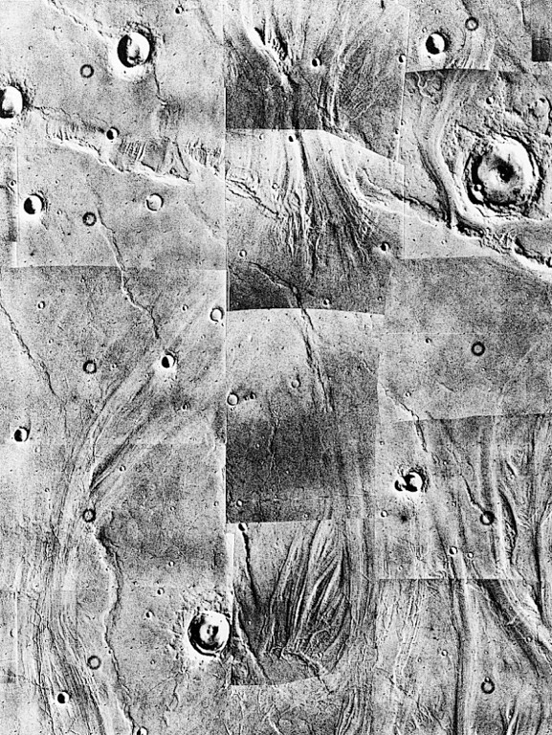













Water on Mars
A ncient Mars had flowing water on its surface.
T hese images clearly show the results of what appears to have been flowing water.
❖ The Viking landers actually recorded frost forming, then evaporating.
T here does not seem to be any liquid water on Mars today.
❖ It is possible that there may be surface water in shallow lakes under ice.

Slide 20
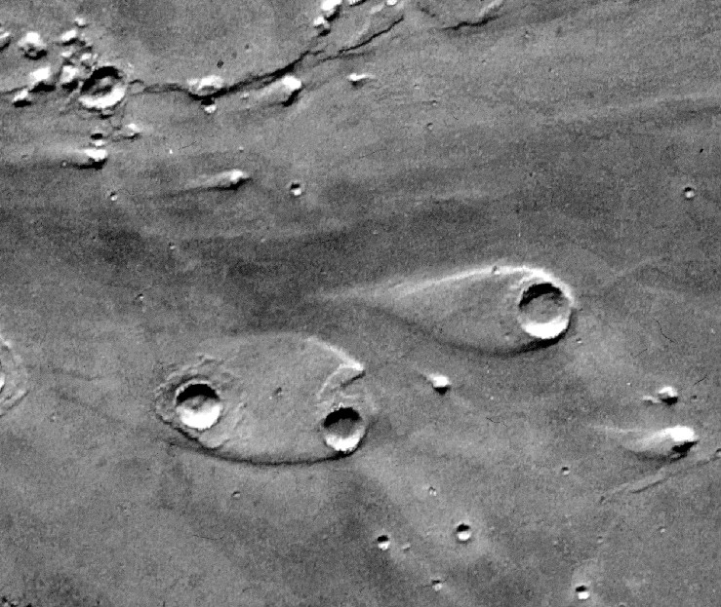
Channel Islands

Slide 21
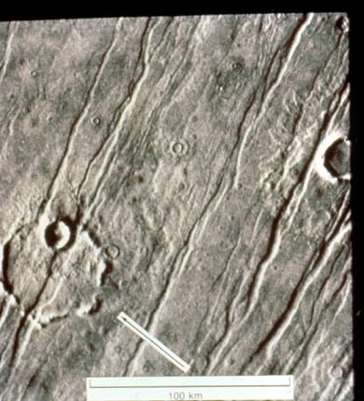
Crater Erosion, Lobate Ejecta

Slide 22
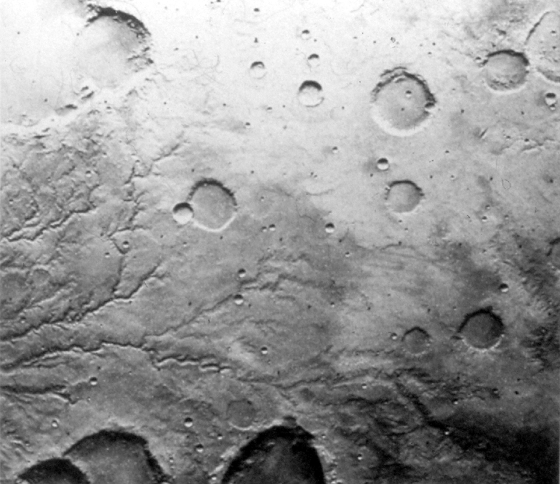
River Channels?

Slide 23
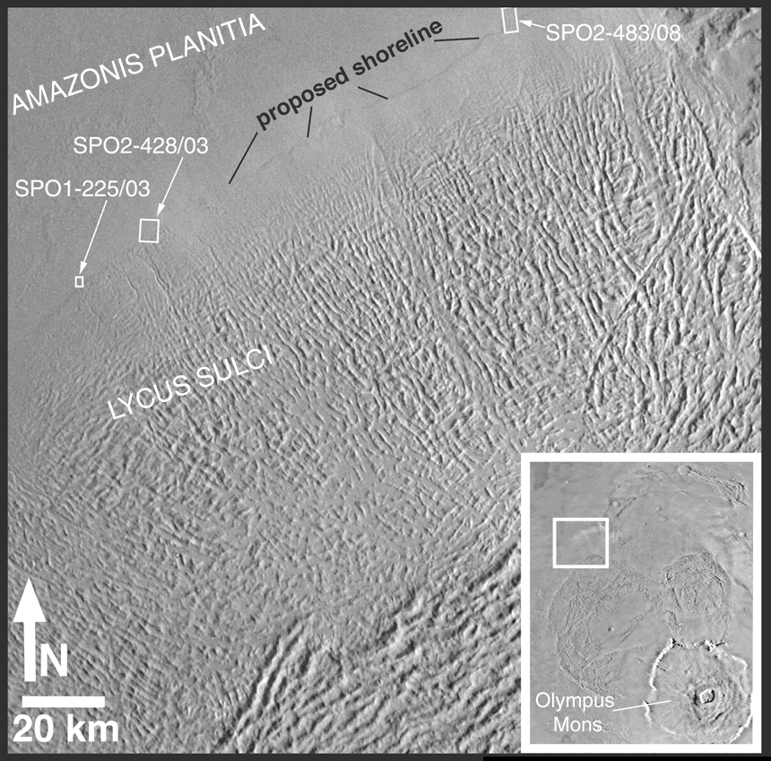
Ancient Martian Shoreline?

Slide 24
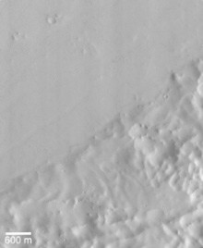
Shoreline? – Up Close and Personal

Slide 25
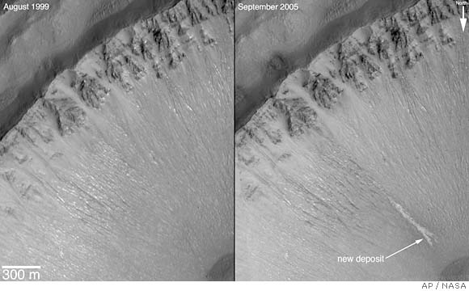
Current Groundwater Flow?

Slide 26
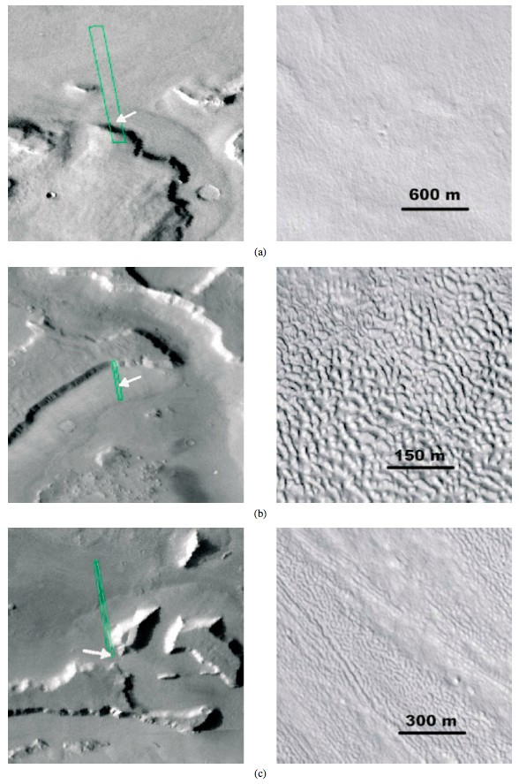
MOC wide angle
MOC narrow angle
Debris Aprons
(a) Smooth surface texture may represent original apron surface
(b) Pitted surface texture may develop through ice sublimation induced collapse
(c) Ridged texture
Li, Robinson, Jurdy (2005)

Slide 27
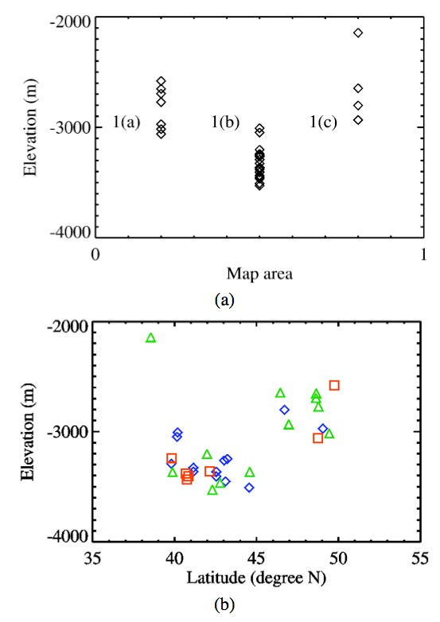
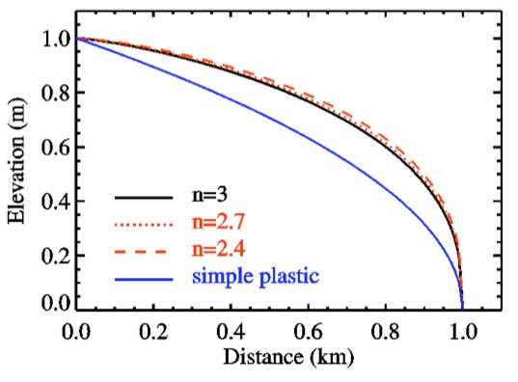
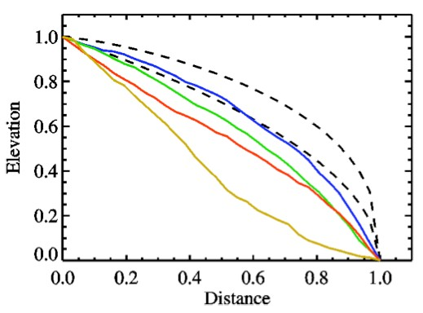
Li, Robinson, Jurdy (2005)
Debris Apron Models
Above: Longitudinal profile predicted by viscous power law model when n varies within the range of 2.4 to 3.
Above: Relationships between apron type and (a) elevation and (b) latitude (type I blue diamond shape, type II green triangle, type III red square).
Left: Composite profiles of three types of lobate debris aprons and Valles Marineris landslide, normalized to unit length and thickness.

Slide 28
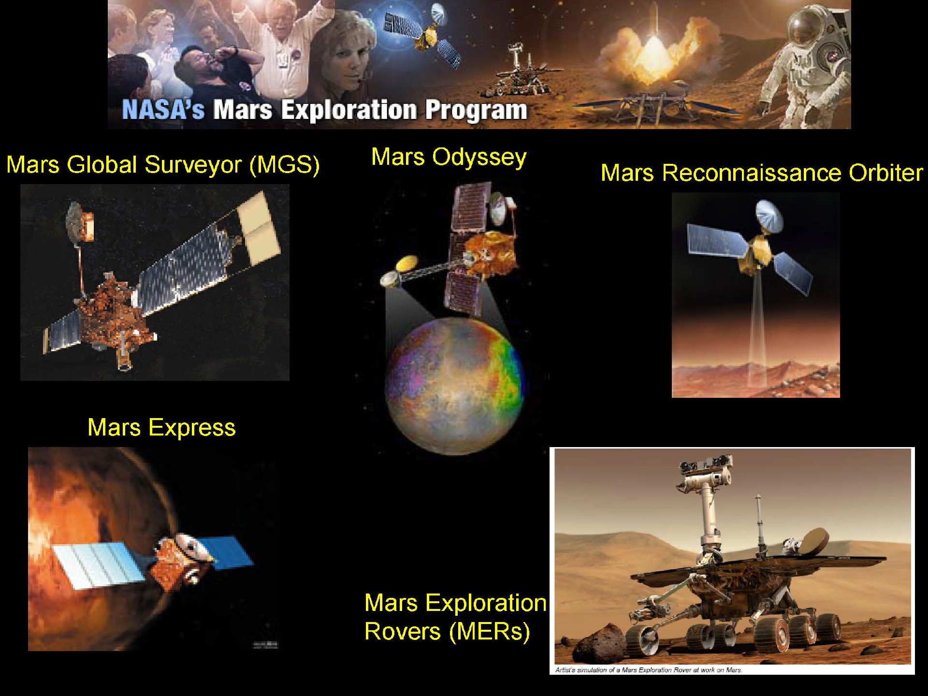

Slide 29
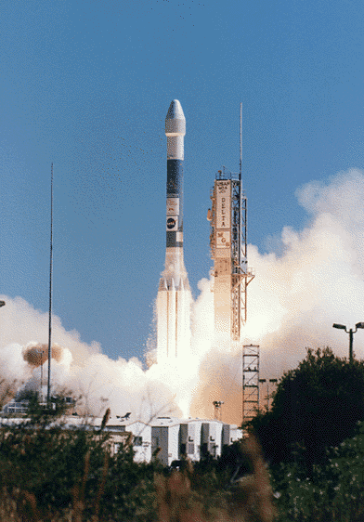
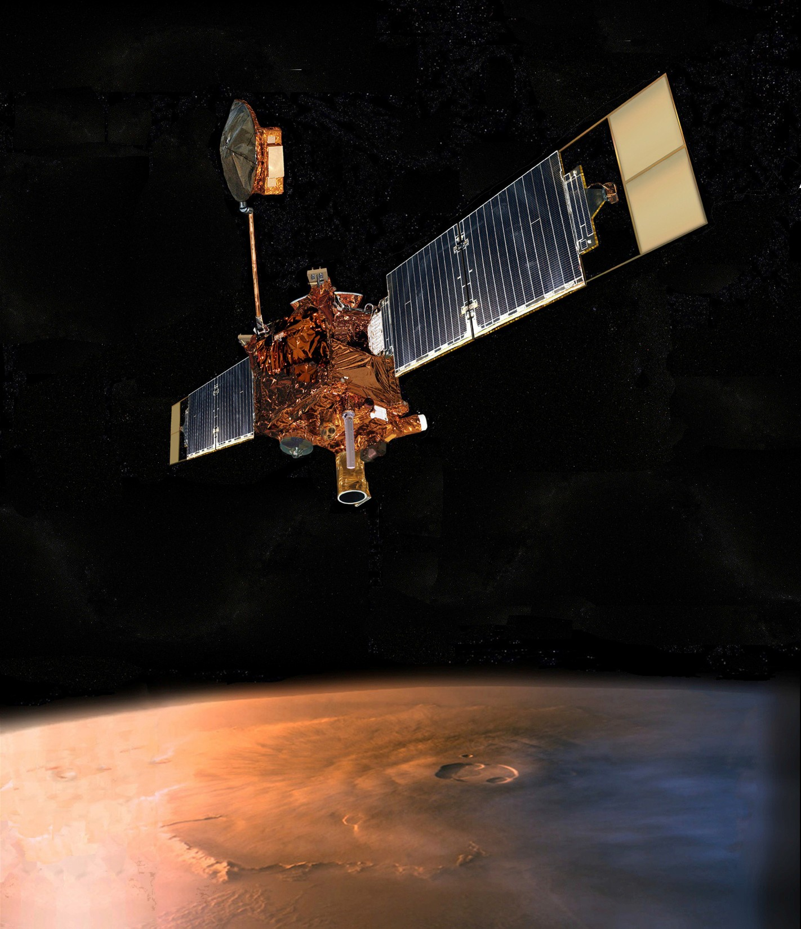
Mars Global Surveyor Liftoﬀ
November 7, 1996

Slide 30
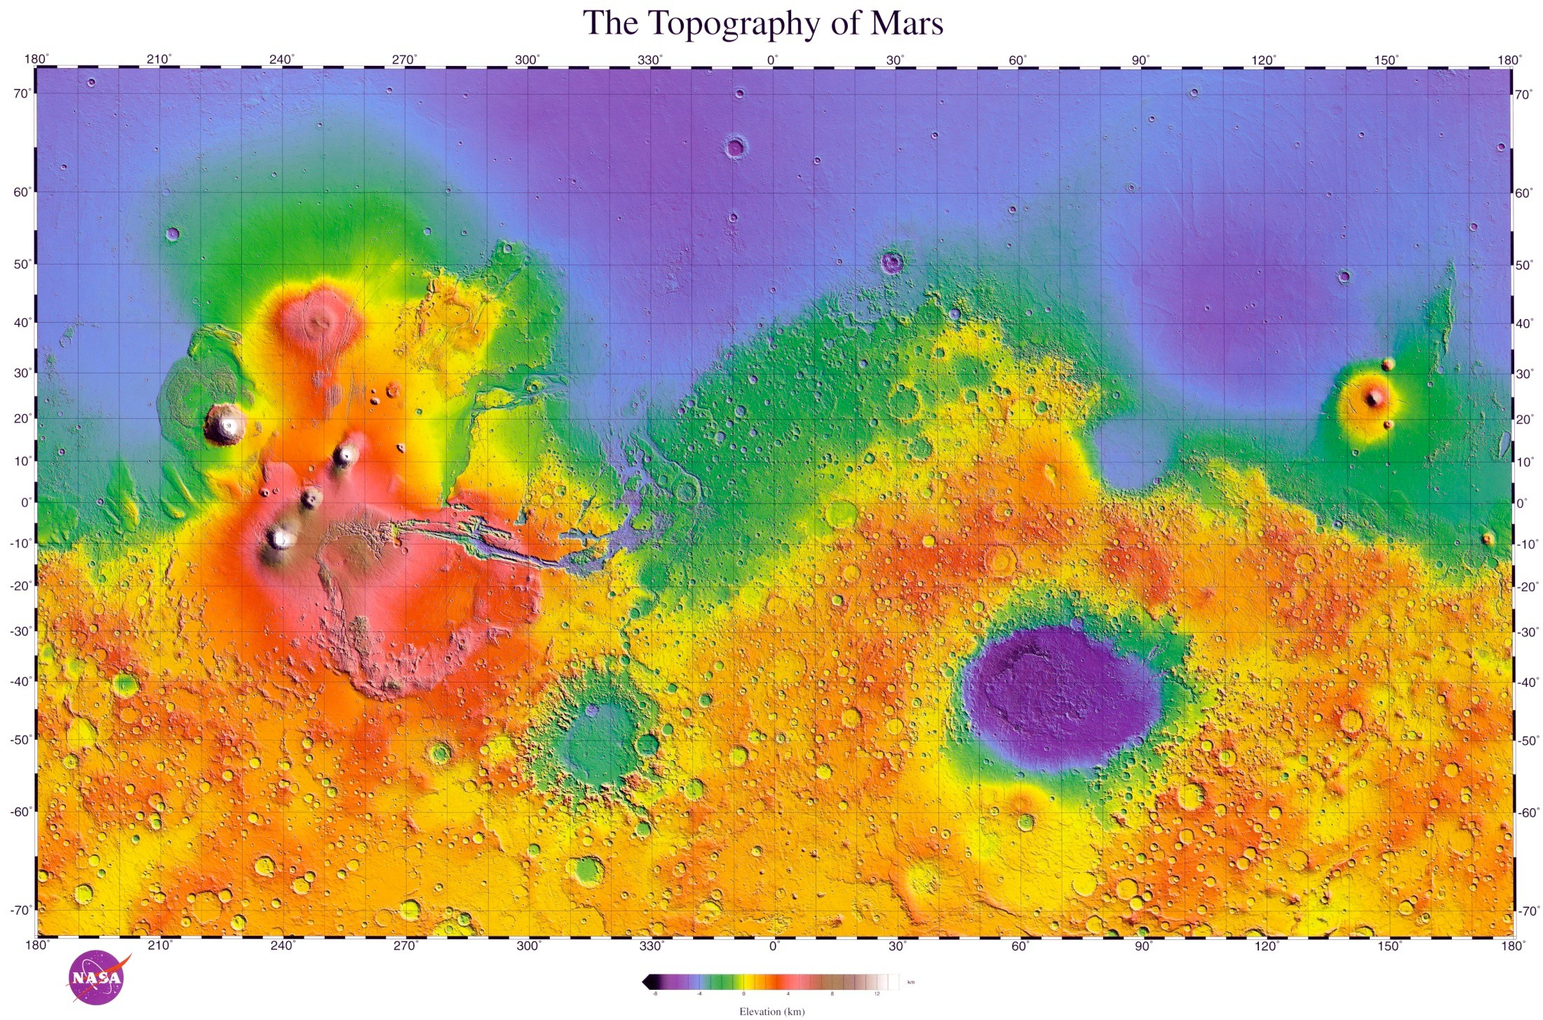
O
S

Slide 31
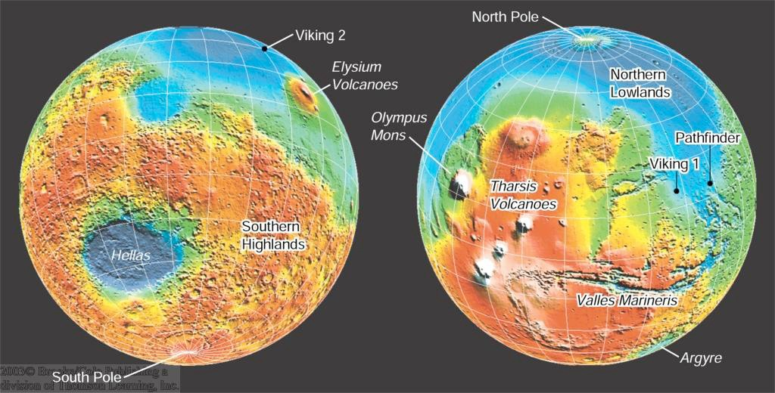
The Geology of Mars
Northern Lowlands: Free of craters; probably re-surfaced a few billion years ago.
Possibly once filled with
water.
Southern Highlands: Heavily cratered; probably 2 – 3 billion years old.

Slide 32
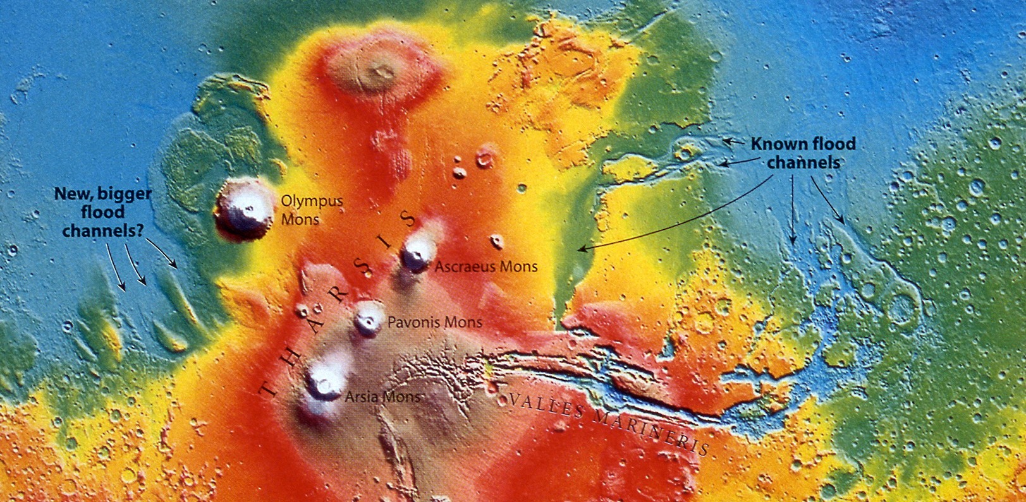
Tharsis Region Topography

Slide 33
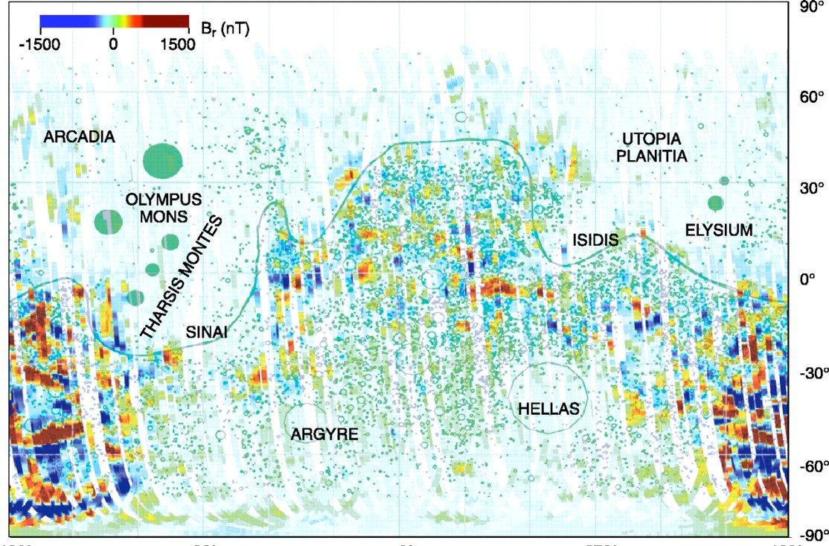
Martian Magnetics

Slide 34
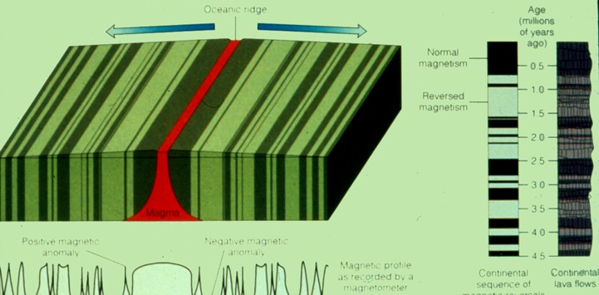
Generation of Magnetic Lineations

Slide 35
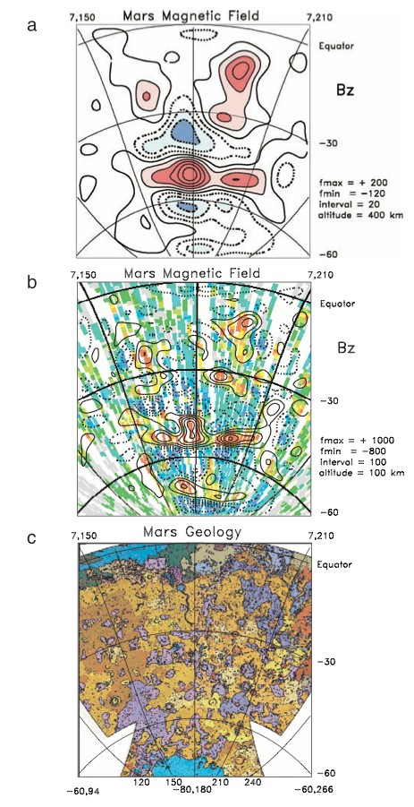
Magnetization of Mars
Figure:
The vertical component of the magnetic field B_{z} as measured at 400 km.
The vertical component of the magnetic field B_{z} extrapolated downward from 400 to 100 km using a Fourier transform. The result agrees very well with aerobraking data obtained at 100 km (shown in color) and fills in data gaps. Aerobraking data: red, strongly positive; blue, strongly negative.
Geology of Mars’ highland terrain.
Jurdy and Stefanick (2004)

Slide 36
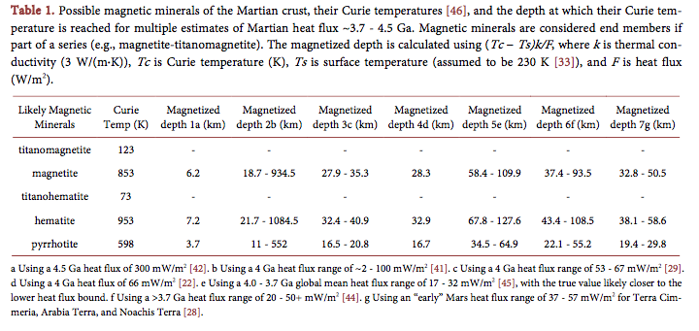

Slide 37
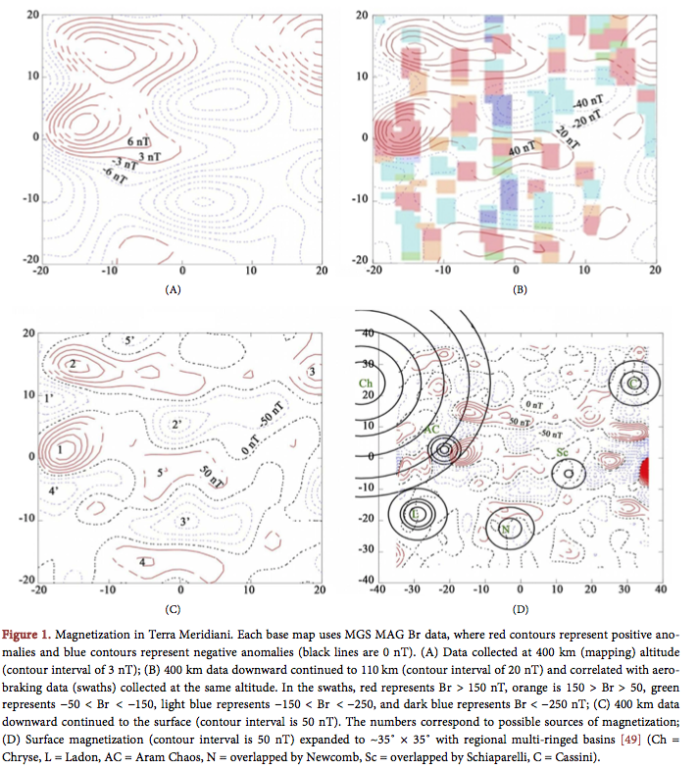

Slide 38
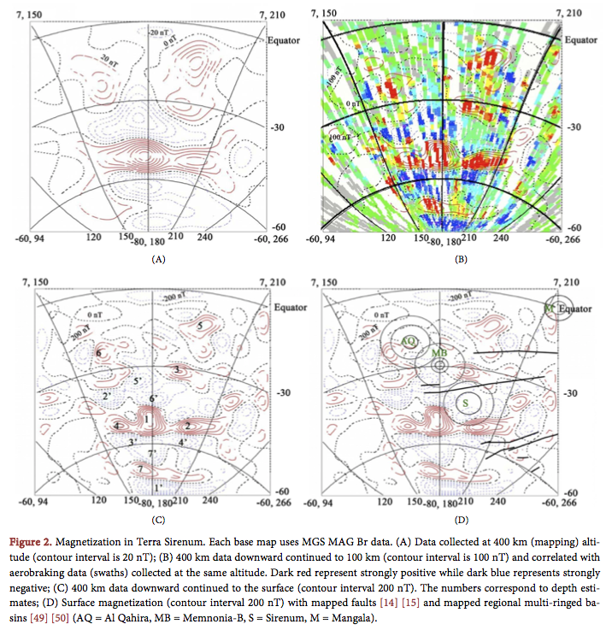

Slide 39
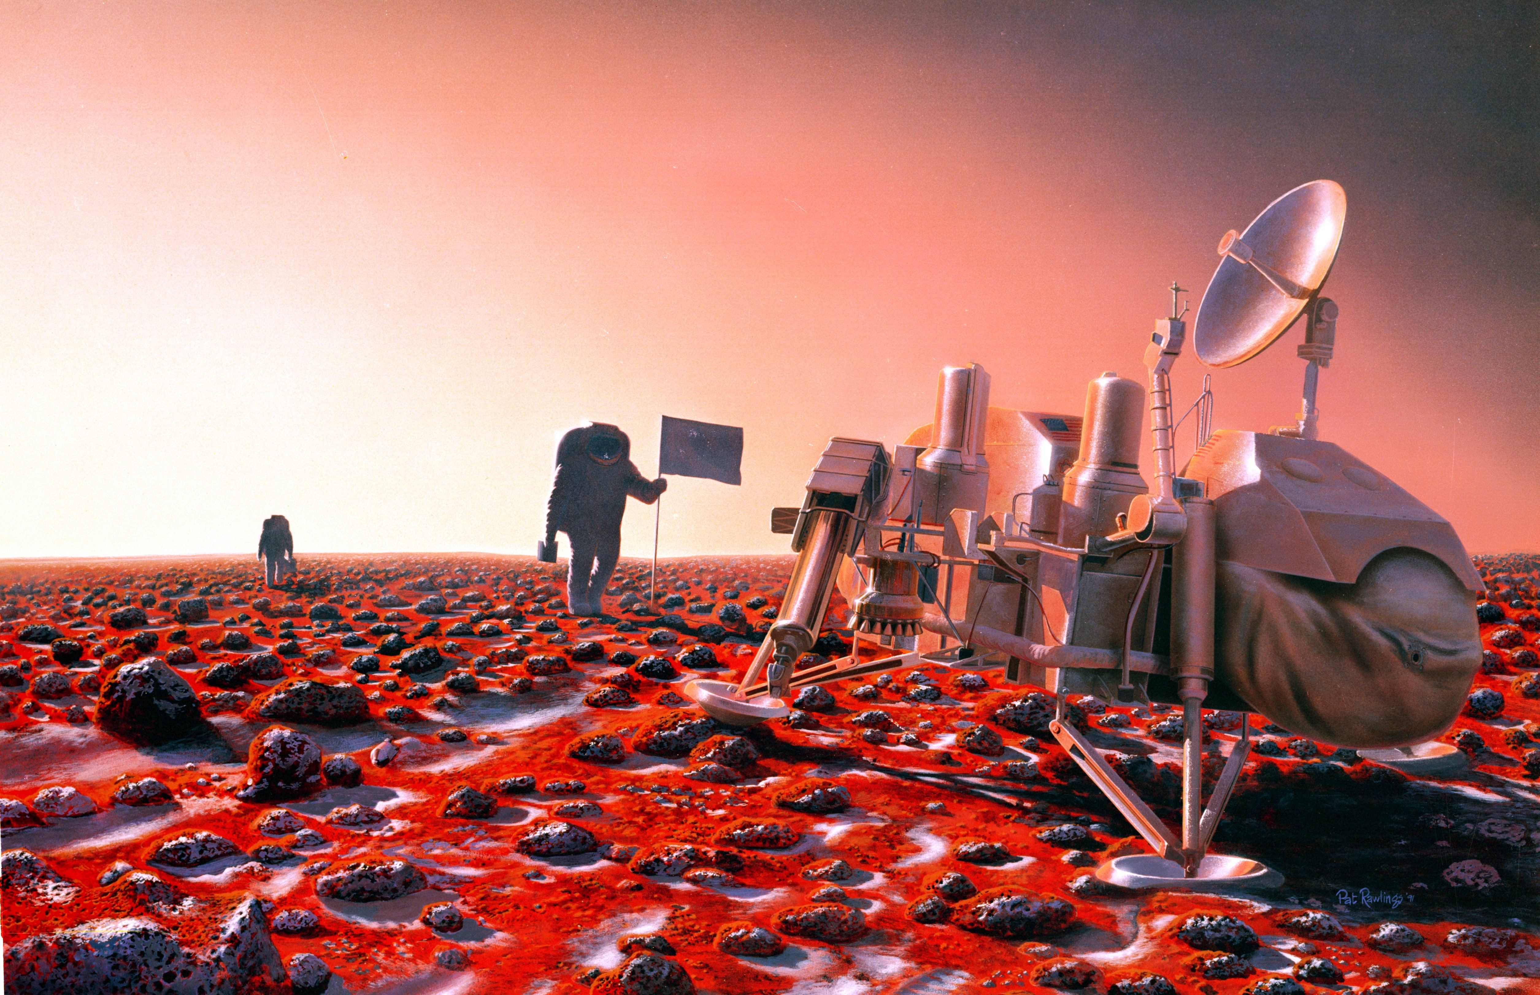
Humans on Mars may visit the site of the Viking 2 Lander to see the effects on the spacecraft.
Viking 2, launched 9/9/75, entered orbit 8/7/76. Viking 2 Lander reached Utopia Planitia on 9/3/76.
The two Vikings delivered seismometers mounted on the landers' legs. Viking 2 Lander ended
communication on 4/11/80. To this day no seismometer has monitored the martian surface.
(NASA by image Pat Rawlings. Technical concepts, Johnson Space Center,1991).
(NASA by image Pat Rawlings. Technical concepts, Johnson Space Center,1991).

Slide 40
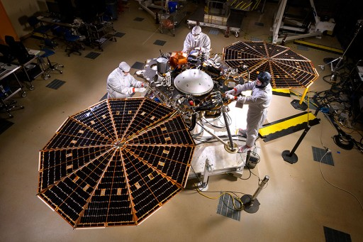
INSIGHT Mars Mission
Interior Exploration using Seismic Investigations, Geodesy and
Heat Transport.
Mission will be first to study the martian interior
Launched May 5, 2018
Drilling stopped.,
Drilling with a Mars landing scheduled for Nov. 26, 2018.

Slide 41
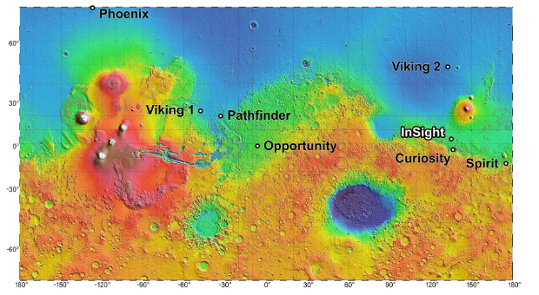

Slide 42
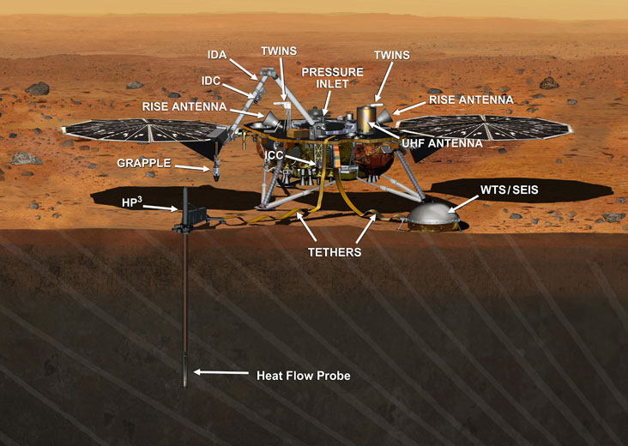

Slide 43
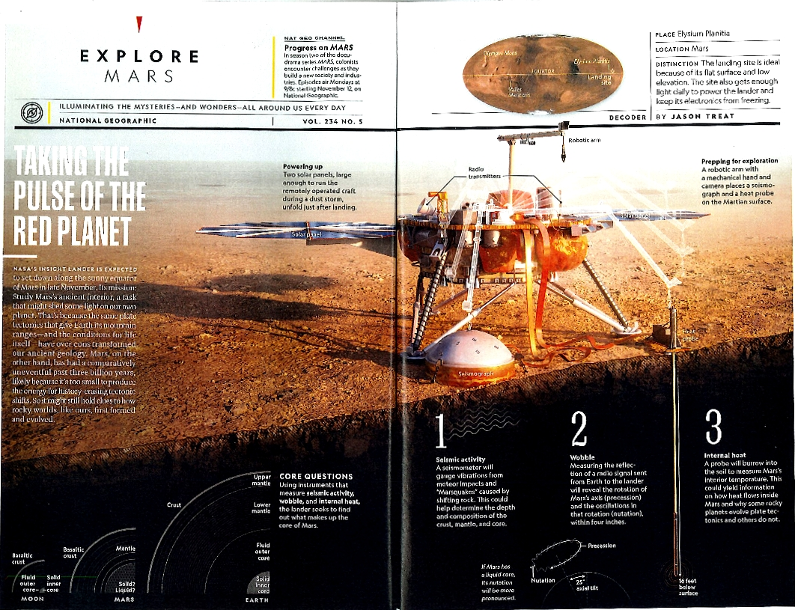

Slide 44
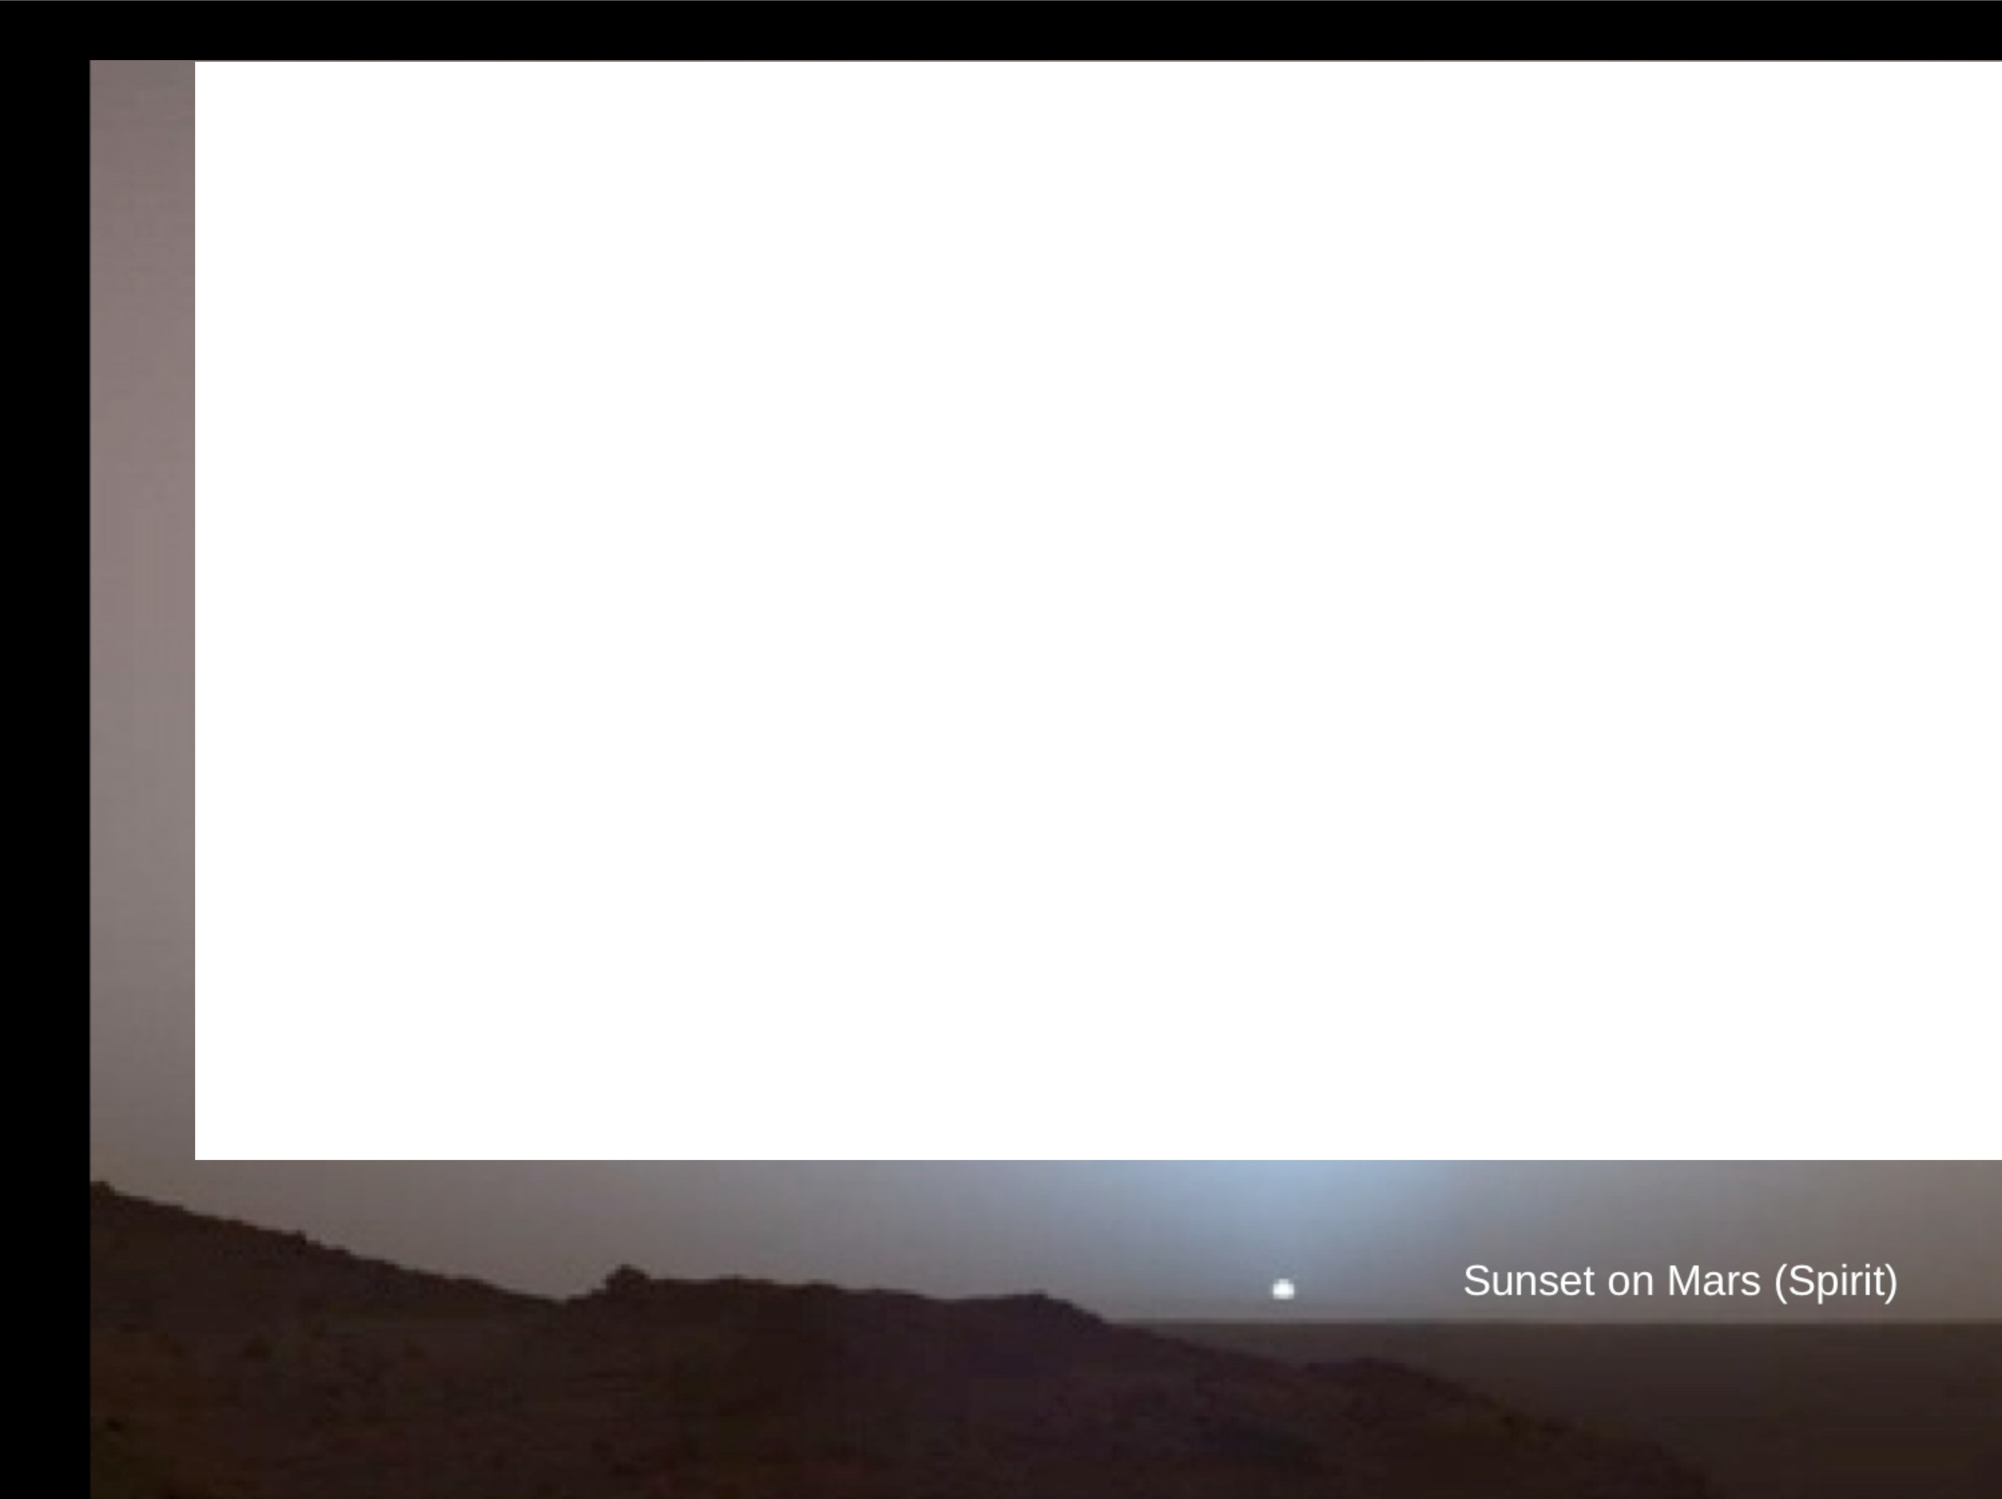
Conclusions
Mars had a strong magnetic field early in its history.
Martian crust is either very strongly magnetized or goes to great depth. Perhaps both.
Magnetic mineral carrier remains unknown.
True Polar Wander may have occurred on Mars, as evidenced by location of Tharsis.
The lnSight lander, with seismometer and heat flow experiments, now on Mars' surface as the first mission to study the interior. Drilling suspended.

